Slide 1

AI-Bsed SME Business Growth Prediction System
by
Nandini G
Roll No. 234G1A05A5
Nandini U
Roll No. 234G1A05A8
Swathi K
Roll No. 234G1A05G2
Meghana Y
Roll No. 234G1A0595
Under the guidance of
Mr. M. Narasimhulu, M. Tech, Ph.D.
Assistant Professor
Department of Computer Science and Engineering
Srinivasa Ramanujan Institute of Technology
Autonomous
Rotarypuram Village, B K Samudram Mandal, Ananthapuramu – 515701.
2026-2027

Slide 2

Contents
Research Gaps Identification
Problem statement
Objectives of Project
Proposal System
Title Justification (Tentative)
Abstract
References
GitHub Link
Queries

Slide 3
Research Gaps Identification
Limited Generalizability Across SME Sectors
Existing SME growth prediction studies often focus on specific sectors such as food processing or manufacturing, limiting their applicability to different types of SMEs.
2. Prediction Without Actionable Business Guidance
Existing approaches mainly focus on predicting sales, profit, efficiency, or firm performance. There is a need to go beyond prediction by identifying the factors influencing growth and providing actionable business guidance.
3. Static and Limited Historical Analysis
Several approaches rely on static or cross-sectional business data and have limited ability to analyse long-term business trends. There is a need to use periodic business data to monitor changes in revenue, expenses, customers, and profit over time.
4. Lack of User-Oriented Explainability
Although Explainable AI techniques such as SHAP and LIME are increasingly used, there is a need to present model explanations in a simple and understandable form for non-technical SME business users.

Slide 4
Problem Statement
Problem Statement
Small and Medium Enterprises (SMEs) often generate valuable financial and operational data, but many small business owners lack intelligent tools to analyse this information and understand their future business growth.
Business information includes:
Revenue, Expenses, Number of customers, Marketing expenditure, Loan EMI, Historical business records
Problem
It is difficult for SME owners to:
Predict future growth from historical business performance.
Identify the major factors influencing growth or decline.
Understand why an AI model produced a particular prediction.
Identify potential business risks at an early stage.
Convert prediction results into useful business decisions.

Slide 5
Objectives of Project
Objective 1
To develop machine-learning models using historical SME business data to predict business growth and forecast future revenue.
Objective 2
To analyse historical business trends and use Explainable AI (SHAP) to identify the key factors influencing growth, performance, and potential risks
Supporting Objectives
Collect and preprocess SME business data.
Analyse revenue, expenses, customers, profit, marketing, and other business indicators.
Compare suitable ML models for growth prediction.
Identify important growth factors and potential risks.
Present predictions, explanations, forecasts, and recommendations through a dashboard.

Slide 6
Proposed System
AI - Based SME Business Growth Prediction System
The proposed system uses AI/ML to analyse historical and monthly SME business information, predict expected growth, and provide explained, personalised guidance.
Input Parameters
Business profile: sector, location, business age, employees
Monthly revenue and number of customers
Expenses: raw material, salaries, rent, utilities, marketing, other
Loan EMI
Calculated indicators: profit, margins, growth rates, cost ratios
AI/ML Models
Random Forest, XGBoost for growth classification, Holt-Winters / ARIMA for revenue forecasting
System Outputs
Growth Status (High Growth / Stable / At Risk), 3-Month Revenue Forecast, Key Factors Influencing Prediction, Business Risk Indicators, Periodic Risk Reports, Personalised Recommendations
Workflow
SME Business Data → Data Preprocessing → XGBoost + Random Forest → SME Growth Prediction → ARIMA / Holt-Winters → Revenue Forecasting → SHAP Explainability → Business Risk & Performance Analysis → Personalised Recommendations → Dashboard

Slide 7
Title Justification
AI – Based SME Business Growth Prediction System
AI-Based: uses machine learning for classification and forecasting, with explainable AI.
SME Business Growth Prediction: predicts growth status and forecasts revenue for small and medium businesses.
Explainable and Personalised: uses SHAP to explain each prediction and gives guidance based on the individual business's own data.
Risk Reports and Recommendations: detects business risks and provides periodic reports and recommendations.

Slide 8
Abstract
Small and Medium-sized Enterprises (SMEs) generate business data such as sales, expenses, customer activity, and profit, but many small businesses lack intelligent systems to analyse this information according to their individual business conditions and goals. Existing business analysis and prediction approaches often rely on predefined datasets and generalized models, which may not capture the unique patterns, historical performance, and targets of a particular business. Therefore, there is a need for a personalised system that can continuously analyse SME performance and identify important changes, growth factors, and potential risks.
This project proposes a AI-Based SME Business Growth Prediction System that analyses an individual business using its historical records, business baselines, and owner-defined targets. The system uses XGBoost and Random Forest for growth analysis, ARIMA and Holt-Winters for revenue forecasting, and SHAP for explaining important factors influencing predictions. Rule-based analysis identifies potential risks, while Generative AI converts analytical results into simple business insights and personalised recommendations. By comparing current performance with historical data and predefined goals, the system aims to help SME owners understand their business performance and make data-driven decisions.

Slide 9
References
[1]. Debdatta Saha, Timothy M. Young, and Jessica Thacker, “Predicting firm performance and size using machine learning with a Bayesian perspective”, Machine Learning with Applications, Vol. 11, 2023.
[2]. Mustafa I. Al-Karkhi and Grzegorz Rządkowski, “Innovative machine learning approaches for complexity in economic forecasting and SME growth: A comprehensive review”, Journal of Economy and Technology, Vol. 3, 2025.

Slide 10
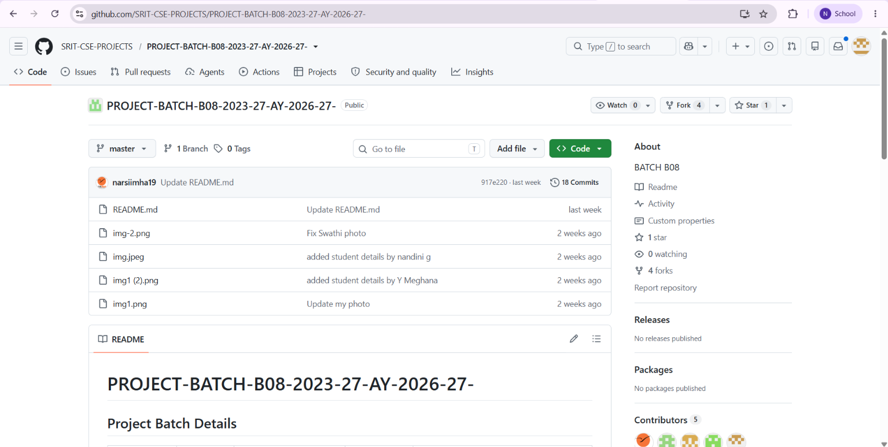
Git Hub Dashboards of each student
https://github.com/SRIT-CSE-PROJECTS/PROJECT-BATCH-B08-2023-27-AY-2026-27-.git

Slide 11
Any Queries?

